Slide 1
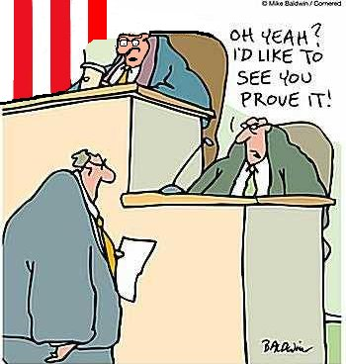
Writing a
DBQ Essay

Slide 2

Prompt = Why did Islam spread so quickly?
  ANALYZE: examine relationships
  DESCRIBE: tell about something in detail
  EXPLAIN: clarify causes or reasons
  IDENTIFY: find and connect specific events
  EVALUATE: judge and discuss the value of

Slide 3

Thesis = a statement of the writer’s position that he/she supports or proves with evidence
Simply put, a thesis is:
One sentence that sums up the writer’s answer to the prompt’s question
The writer’s main point that sets the direction for the entire essay

Slide 4
Historical Evidence = facts + analysis
Specific details
from history:
Dates
Names
Events
Locations
THINK:
How does each fact support your thesis?
Explain connection and make your point to reader!
Ask yourself, “So what?” Explain how facts relate to and support your position (thesis).

Slide 5


References in the Outline
Introduction
Thesis statement:
One of the three examples of historical evidence must include a document reference
Name of document only
(save detailed writing for draft)
2
3
4
Conclusion

Slide 6
*You’ll write detailed document references in your DBQ draft.
Prewrite/Box Outline*
Write Draft*
Ratiocinate
Edit/Revise/ Complete Essay
Step 2: Expand organized ideas from box outline to five paragraph essay

Slide 7
Writing References
DO refer to documents.
DON’T forget to use them.
DO identify documents by title or description, such as, “Franklin’s cartoon illustrates…”
DON’T footnote or tag documents, such as “Document A illustrates…”
DO paraphrase documents.
DON’T quote, copy, rewrite or list the documents.

Slide 8
Writing References cont.
DO explain how documents support your answer.
DON’T just restate content of documents.
DO use power verbs like represents, illustrates, portrays, exemplifies, depicts, reveals, demonstrates, indicates and symbolizes .
DON’T use weak verbs such as show, feel or believe.
DO write to a sophisticated audience.
DON’T use words like good, bad, etc.

Slide 9


Use Third Person
1st Person: All about #1
(I, me, we, us, our)
2nd Person: Two = you
(you, your, yours)
3rd Person: Write as reporter using:
he, she, it, him, her, them, they, its, their

Slide 10
You will ratiocinate document references along with the other elements of your DBQ Essay.
Prewrite/Box Outline
Write Draft
Ratiocinate
Edit/Revise/ Complete Essay
Step 3: Color code your draft

Slide 11

COLOR CODE
1. Using the highlight function, highlight the THESIS STATEMENT in GREEN.
2. In the body paragraphs, highlight the TOPIC SENTENCES in GREEN.
3. In the body paragraphs, highlight any information that comes specifically from any of the DOCUMENTS in ORANGE
4. In the body paragraphs, highlight any OUTSIDE INFORMATION in YELLOW
5. In the conclusion, underline the RESTATED THESIS STATEMENT in GREEN.
6. In the conclusion, highlight the SUMMARY of each document or argument in ORANGE.

