Slide 1
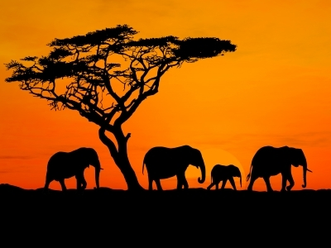
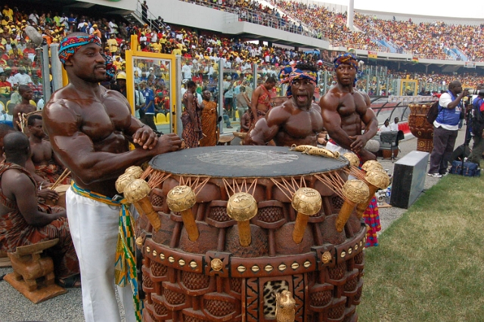
Warm Up January 14, 2014
“Images of Africa”
Respond to the following prompt:
“When you envision Africa, what do you see in your mind’s eye?” Continue to write until time is called. Be prepared to share your response with the class.

Slide 2
Standards
SS7G1 The student will locate selected features of Africa.
a. Locate on a world and regional political-physical map: the Sahara, Sahel, savanna, tropical rain forest, Congo River, Niger River, Nile River, Lake Tanganyika, Lake Victoria, Atlas Mountains, and Kalahari Desert.
b. Locate on a world and regional political-physical map the countries of, Democratic Republic of the Congo (Zaire), Egypt, Kenya, Nigeria, South Africa, and Sudan.

Slide 3
Essential Question
How has the location of the countries of Africa impacted the continents development?

Slide 4
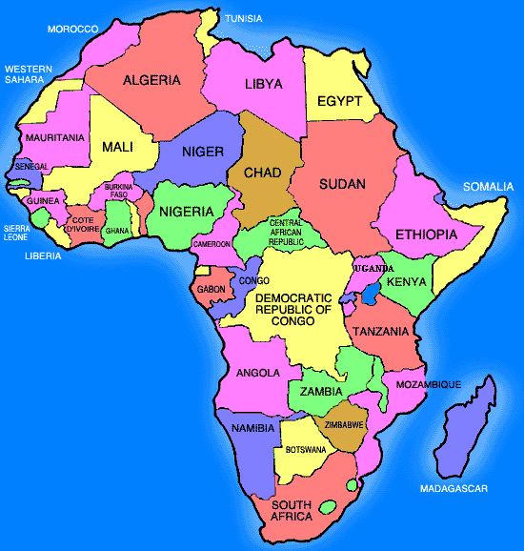
The Africa You Never See on TV!
Watch the following video clip. What did you find most surprising about Africa? Why? Be prepared to share your response with the class.
http://www.youtube.com/watch?v=K1c4V47VjSk

Slide 5

Use this video and your textbook to help you label the political and physical map of Africa.

Slide 6
Lesson Reflection Log
Complete the following 3 statements:
(1) Key ideas from this discussion were….
(2) Connections I can make with other ideas are…. and
(3) Questions I still have are….

Slide 7

Homework
Finish and study your maps of Africa. Your map will be due at the beginning of class tomorrow. We will have a quiz Friday! The quiz will cover the geography of African and the environmental issues of Africa.

