Slide 1
Hello!- 10/5/15
#1. Enter and sit quietly
#2. Complete the Warm up below:
The country of Kosovo seeks to improve its standard of living. Which program could assist them in accomplishing that goal?
A) a program that builds more airplanes
B) a program that increases the number of police
C) a program that teaches workers how to handle money
D) a program that assists adults in learning to read and write

Slide 2
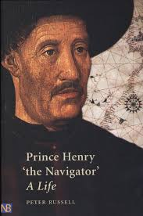
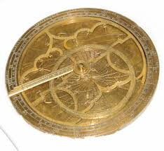
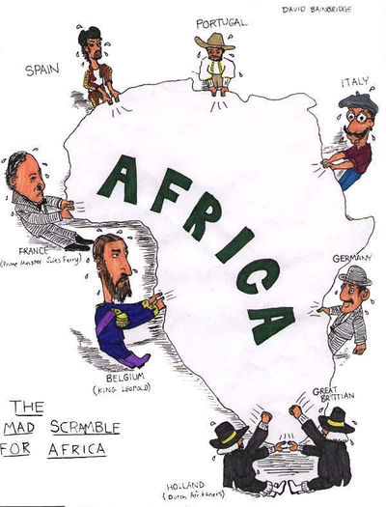
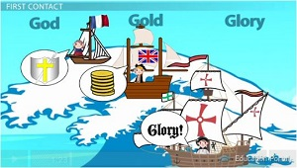
Twenty Questions

Slide 3
Standards
SS6H6 The student will analyze the impact of European exploration and colonization on various world regions.
a. Identify the causes of European exploration and colonization; include religion, natural resources, a market for goods, and the contributions of Prince Henry the Navigator.
b. Trace the empires of Portugal, Spain, England, and France in Asia, Africa, and the Americas.
c. Trace the colonization of Australia by the United Kingdom.
d. Explain the impact of European empire building in Africa and Asia on the outbreak of WWI.

Slide 4
Essential Question
What motivates people to take great risk and explore unknown territory?

Slide 6
European Exploration
& Colonization
Portugal, Spain, England, & France

Slide 7
European Exploration
& Colonization
Portugal, Spain, England, & France

Slide 8
The 3 G’s…
Why did Europeans go exploring?
GOLD
New trade routes opened up opportunities for wealth.
GOD
Missionaries wanted to spread Christianity.
GLORY
Explorers were considered famous heroes; countries competed for colonies.

Slide 9
The Crusades
The Crusades were military expeditions sent by the Catholic Church to capture the Holy Land from the Muslim Turks.
They were not successful, but did have a few positive results:
Europeans learned to draw better maps and
build better ships.
Exposed Europeans to spices & goods from
the East.

Slide 10
Trade Routes
In the 1400s, major trade routes from the East to Europe went through 2 Italian cities (Venice & Genoa).
Italian merchants marked up the prices on the
goods & sold them throughout Europe.
Other European countries resented the huge profits made by Italians & began to look for other routes to the East…

Slide 11
Trade Routes
Europeans created new trade routes to bring products from Europe to India, China, & the Spice Islands.
This greatly contributed to the expansion of the empires of Portugal, Spain, England, and France.

Slide 13
Portugal’s Empire
1n the 15th century , Portugal led the world in sea exploration and explored the western coast of Africa.
The Portuguese wanted to find a trade route around Africa to Asia because:
They believed they could make a lot of money as traders if they could get Asian goods for a cheaper price.
They also wanted to spread Christianity along Africa’s west coast.

Slide 14
Prince Henry the Navigator
He was the son of the Portuguese king.
He sent more than 50 expeditions down the west coast of Africa.
o He wanted to establish Portuguese colonies &
break the Muslim hold on trade routes.
He also created a naval observatory that taught students navigation, astronomy, & cartography

Slide 15
Prince Henry the Navigator

Slide 16
Institute of Sagres

Slide 17
Prince Henry the Navigator
He was unable to make much money trading gold, so he tried creating sugar cane plantations.
Sugar cane was a very profitable crop, but required lots of labor.
Prince Henry imported slaves from Africa to work the
fields.
This was successful & was later copied in the New
World.
His actions encouraged a slave trade that lasted another 400 years…

Slide 18
Portugal’s Empire
For the next 300 years, Portuguese sailors continued to explore Africa where they established forts & trading posts.
o By 1571, a string of outposts connected Portugal to Africa, India, South Pacific Islands, & Japan
Portugal grew wealthy from these trade routes,
but its most profitable colony was Brazil.

Slide 19
Spain’s Empire
Spanish explorers were searching for a trade route through or around North & South America to Asia.
They wanted to find a quicker route to the
gold & spices in Asia.

Slide 20
Christopher Columbus
In the 1490s, Columbus, an Italian, was given ships &
sailors by the Spanish monarchy.
o They wanted him to try to find a quick route through the Atlantic Ocean to Asia.
He discovered the Bahamas, but thought he was in
Asia.
o Later, it was realized that he discovered 2 new continents!
Exploration of these areas brought great wealth to Spain.

Slide 21
Christopher Columbus

Slide 22
Spain’s Empire
Spain had a huge empire that spanned the globe.
Spanish conquistadors conquered the Inca and Aztec civilizations in the 1500s (South America). o They were looking for gold & spices.
o They used missionaries to convert natives to
Christianity.
Spain claimed huge areas of North & South America & ruled over them for 300 years.

Slide 23
England’s Empire
In the past, England was one of three countries--
England, Scotland, & Wales.
In the 1700s, the three united and became Great Britain.
The British empire was the largest in history.
o At its peak, Great Britain controlled: Canada, Australia, India, much of Africa, and numerous islands all over the world.

Slide 24
England’s Empire
North America came under British control in the
1700s.
It lost the American colonies in 1776, but maintained control over Canada until the 20th century.
Great Britain colonized Australia in 1788.
It was used as a penal (prison) colony to relieve overcrowded jails in England.

Slide 25
France’s Empire
France possessed colonies around the world
from 1600 to 1900.
It also dominated much of the European continent.
o By 1812, France controlled much of Germany
and Italy.

Slide 26
France’s Empire
France established other colonies in the 16th-17th
centuries:
--Islands in the Caribbean, the Indian Ocean, the South Pacific, the North Pacific, & the North Atlantic
France also maintained influence in Canada, South America, Southeast Asia, & Northwest Africa.

Slide 29
Pick Your Brain
Write down the most important things that you can remember about European exploration from today’s lesson.

