Slide 1
Early Civilizations of Latin America

Slide 2
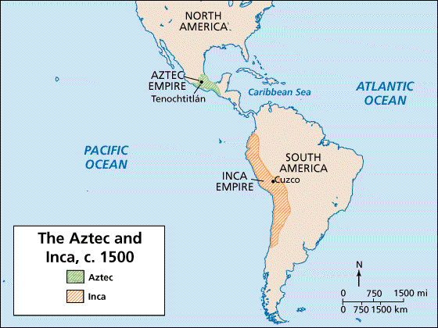
Aztec & Incan Empires

Slide 3
The Aztecs
Part One

Slide 4
The Aztec Civilization
arrived in the Valley of Mexico in 1100s (central Mexico, includes present day Mexico City)
wandered about looking for a home site until 1325
settled on island in the middle of Lake Texcoco
  built a magnificent city called Tenochtitlan (now Mexico City)

Slide 5
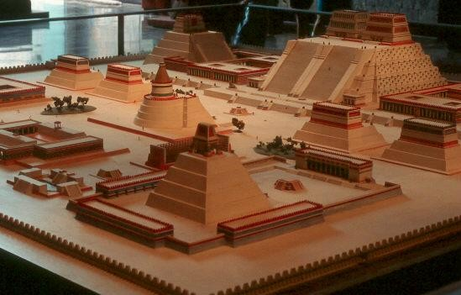
Diorama of Tenochtitlan

Slide 6
Tenochtitlan (Aztec capital)
created in the center of a lake!
built floating islands called “chinampas” by piling rich earth from the bottom of the lake onto rafts made of wood
  roots of plants grew down to bottom, anchoring the rafts

Slide 7
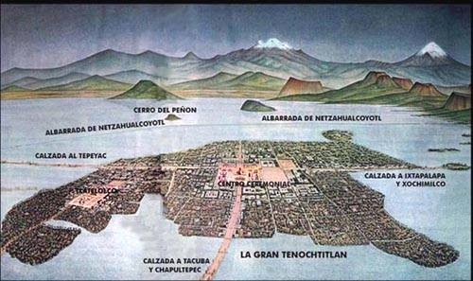
Tenochtitlan

Slide 8
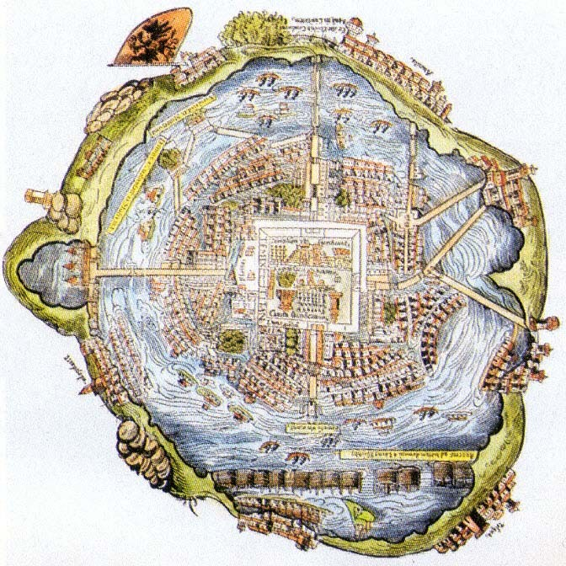
Aerial View of Tenochtitlan

Slide 9
Expanding the Aztec Empire…
1400s—warriors began conquering other people
made them pay taxes€ noble Aztecs grew rich
had an emperor; nobles and priests helped emperor—all were very wealthy
  not everyone was rich—most people were farmers

Slide 10
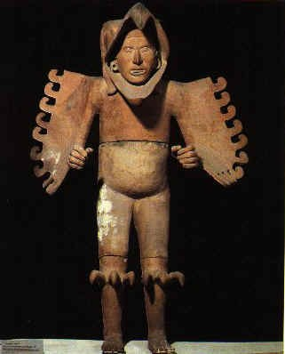
Aztec Warrior Sculpture

Slide 11
Men’s Work
The Aztec were very involved in agriculture.
used chinampas (man-made floating islands) to grow crops of vegetables, flowers, grasses, and medicinal plants
They also hunted and fished.

Slide 12
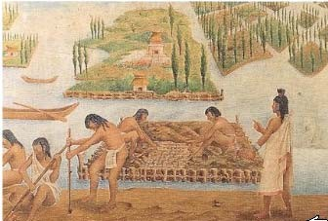

Slide 13
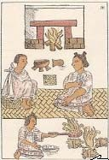
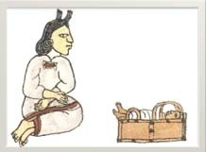
Women’s Work
The Aztec women spent the day taking care of the children, cooking, knitting, and doing housework.

Slide 14
Aztec Achievements
Doctors developed 1,000s of medicines from plants.
Astronomers predicted movements of the planets; designed an accurate calendar!
Priests kept extensive records using hieroglyphics.
Schooling - Boys studied either religion or military skills; girls learned cloth spinning and cooking.

Slide 15
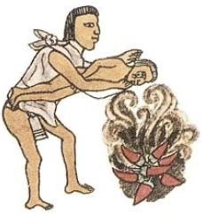
Disciplining Children
Some punishments included making them inhale smoke, holding them over fire in which spicy peppers where thrown, and puncturing their skin with thorns!

Slide 16
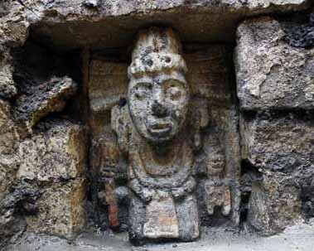
Aztec Religion
Cities were religious centers; they worshipped their gods in pyramid-shaped temples.
Sacrifice was an important part of the religious ceremonies (meant to honor the gods).
Polytheistic (worshipped many gods): Sun, Death, Maize, Rulers, Rain, etc.

Slide 17
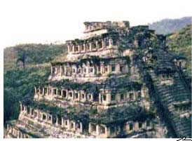
Aztec Temple
Instead of tearing down old temples, Aztec would just keep adding levels to the existing one.
This one was built over 6 times!
Rooms for sacrificing ar at the top.
e

Slide 18
Religious Ceremonies
The bath was an important part of daily life--not only to be cleaned, but also to be religiously purified.
Most homes had a steam room attached to living quarters.
Other religious ceremonies included human sacrifices.
  usually children or prisoners of war
  felt that human hearts and blood strengthened the gods

Slide 19
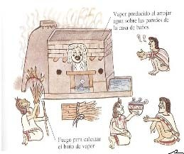

Slide 20
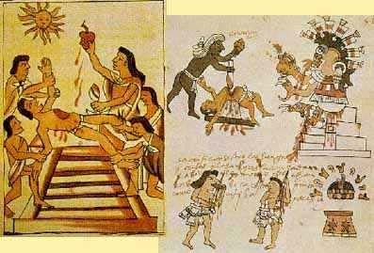
Aztec human sacrifice was on a greater scale than anywhere or any time in human history.

Slide 21
Be the Thing: Chinampas
I am a chinampa of the Aztec civilization. Every day I float on a lake and keep the city whole. I hate staying in place while I let plants grow through my face. Farmers come to harvest crops, only for me to feel the painful sting of having plants ripped off of me. Every time someone steps on me, I feel as if I will sink. This is another pain that I must face.

Slide 22
Be the Thing: Priest’s Hat
I am the hat on the head of the highest priest in all of the Aztec race. Pretty much every week I have to witness the sacrificing of little innocent children, animals, and prisoners. I hate hearing the dreadful screams, cries, and pleas of the sacrifices. And then, eeeeeKKK!! I see a cherry red organ in my owner’s hand, rapidly dripping blood. After that, I hear the thumpity-thump of the sacrifice’s head rolling down each narrow stair step of the enormous temple. I myself am filled with grief. I think I am going to perch myself on top of one of the women that have to work in the house all day. At least I know the only thing they are killing is dinner…

Slide 23
The Inca
Part Two

Slide 24
Rise of the Inca
1200 AD, Incas settled in Cuzco, a village in the Andes Mountains (now in Peru).
  Most were farmers.
1438 AD, Pachacuti became ruler of the Incas and conquered more lands/people.
  empire stretched 2,500 miles and ruled 12 million people
  used runners to spread news—at a rate of 250 miles a day

Slide 25
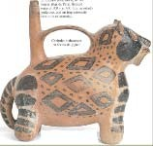
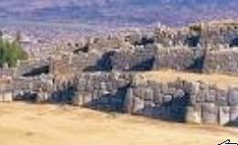
Cuzco
The jaguar was an important symbol to the Incans.
  Cuzco (capital city) was built in the shape of a jaguar!

Slide 26
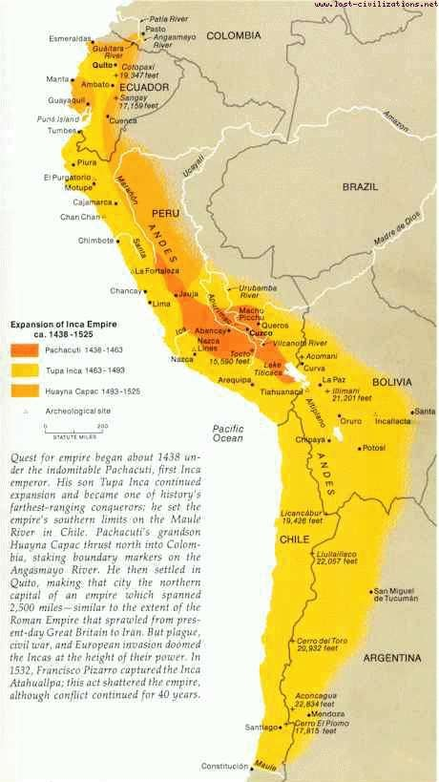
Incan Empire

Slide 27
Incan Accomplishments
excellent farmers, builders, and managers
roads and aqueducts:
  built more than 19,000 miles of roads (over mountains!)
  built canals and aqueducts to carry water to dry areas
    aqueduct—pipe or channel designed to carry water to a distant source; irrigates dry land

Slide 28
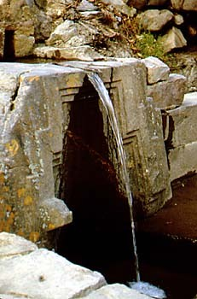
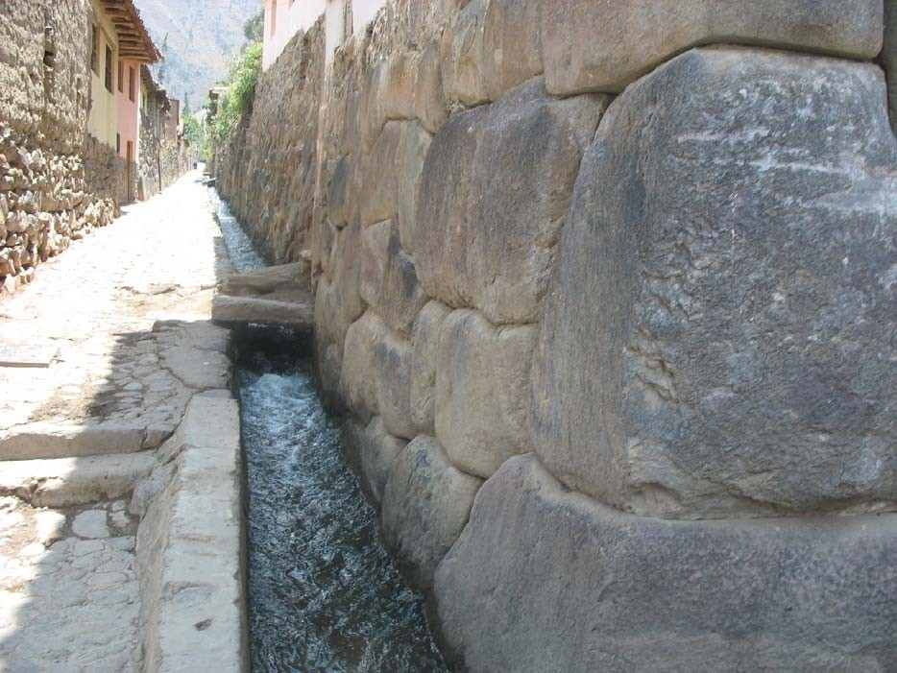
Aqueducts

Slide 29
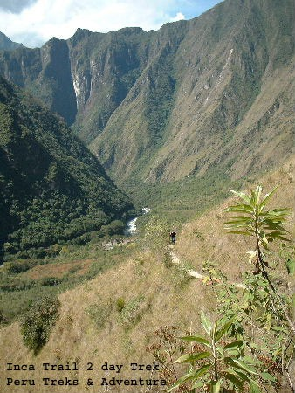
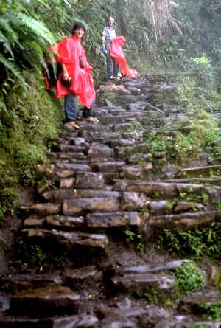
Inca Trails…

Slide 30
Incan Accomplishments (continued)
farming: cut terraces into the Andes to create farmland
  developed a large variety of foods
  discovered ways to store and preserve food
    potato was a staple food (due to it being able to grow in the high altitudes of the Andes)
    other foods: tomatoes, maize, lima beans, peppers, grains

Slide 31
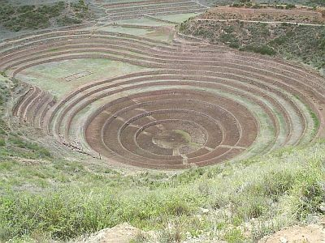
Inca Terraces

Slide 32
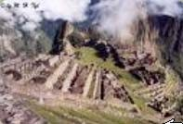
Architecture
Inca ruins are some of the most impressive architecture in the world.
They cut stone with such precisions that each block fit exactly with its neighbor.
  fit was so tight, even a knife wouldn’t fit in the cracks

Slide 33
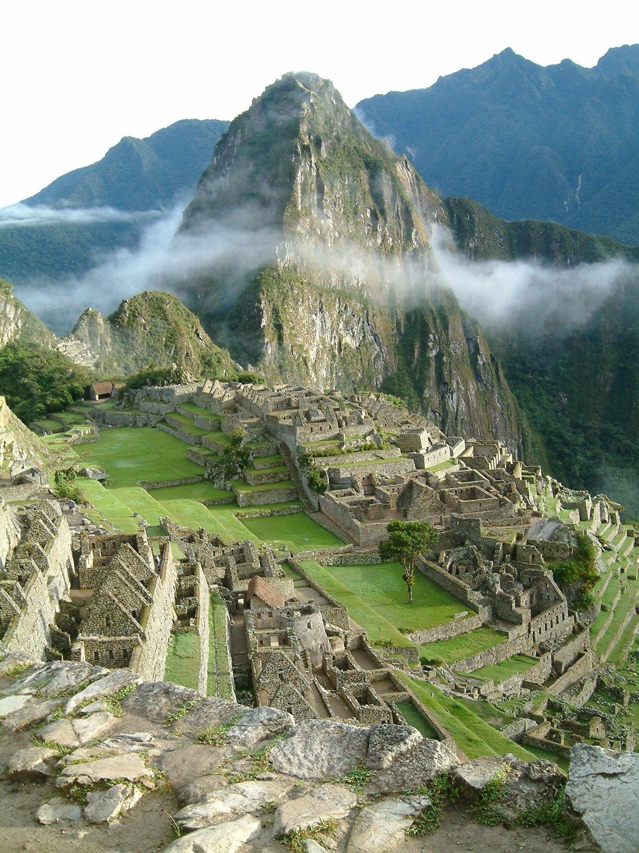
Machu Pichu – Inca Ceremonial Center
Macchu Picchu

Slide 34
Incan Government & Records
nobles conducted a census to count people so they could be taxed
no written language
recorded information on knotted strings called
Quipus:
  each color represented a different item and knots of different sizes at different intervals stood for numbers

Slide 35
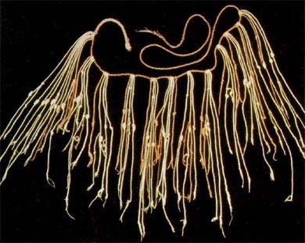
Inca Quipu

Slide 36
Incan Religion
like the Aztec, also polytheistic
  main god was the sun god
Sacrifice was a big part—usually a white llama was used.
believed in reincarnation

Slide 37
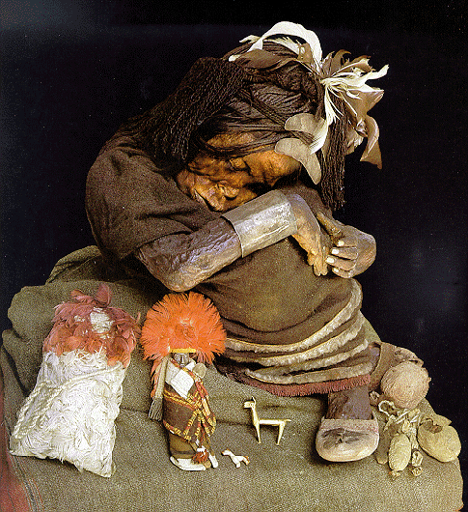
Inca Mummy…500 Year Old Frozen Girl

Slide 38
History Advertisement…
Your Task: Create an advertisement for a technological advance in the Inca civilization. This should be a 1 page advertisement that could be in a magazine or newspaper.
Advertisement must include:
o o o o o
Colorful drawing
Why people should be interested… Price
List of what the item does
“Quote” from an Inca living at the time
Choose one of the following:
Quipu, terrace, jaguar, aqueduct, runner

Slide 39
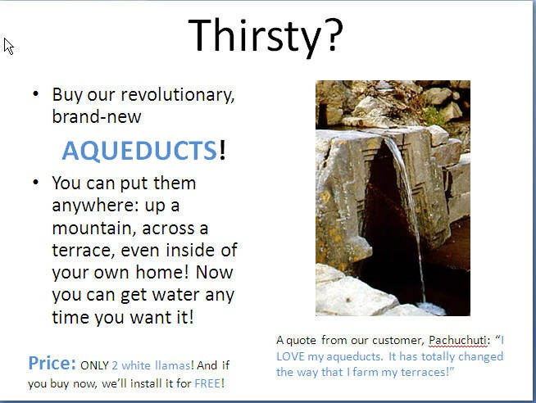

Slide 40
