Slide 1

Environmental Issues
of Canada
Acid Rain and Pollution of the Great Lakes, the Extraction and Use of Natural Resources on the Canadian Shield, and Timber Resources

Slide 2
Acid Rain
Coal-burning factories, cars, & trucks release chemicals that pollute the air.
  The pollutants mix with water molecules in clouds and turn the water acidic.
High levels of acid in rain can damage or kill trees and pollute lakes enough to kill fish.
Houses, buildings, and statues can also be damaged.

Slide 3

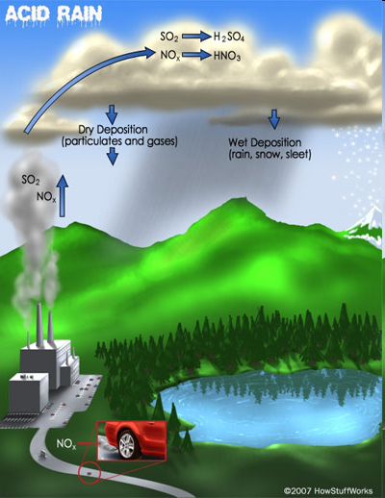

Slide 4
Acid Rain
Southern Canada (near the Great Lakes region) experiences the highest levels of acid rain.
50-75% of the pollution that causes acid rain actually comes from the US.
  Wind patterns tend to move the pollution from the US north into Canada.

Slide 5
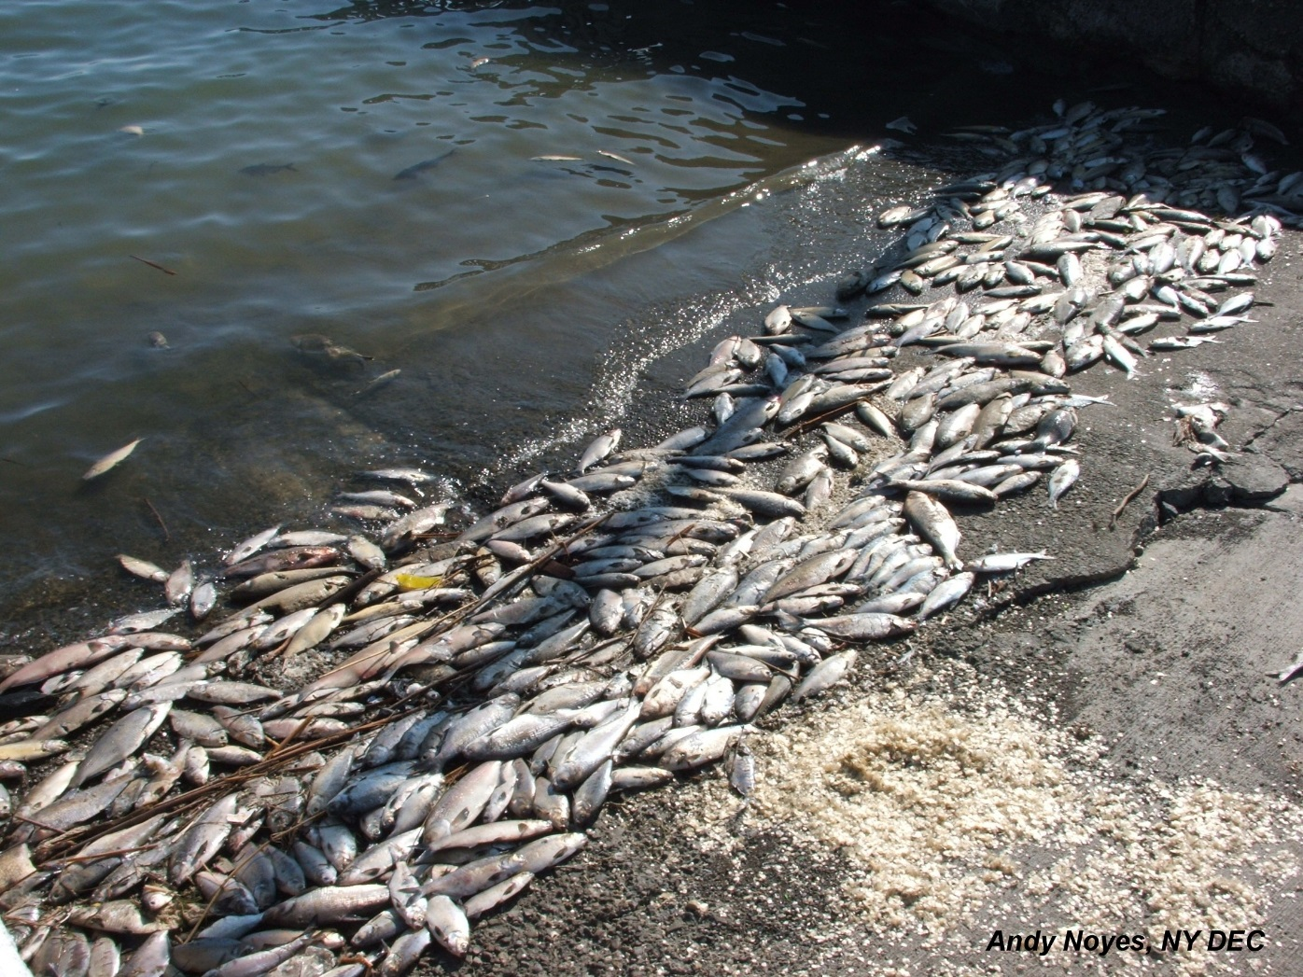

Slide 6
Acid Rain - Solution
Canada’s government has done several things to reduce pollution:
  They are building factories that don’t pollute the air.
  Laws have been passed that require cars to produce less pollution.
  They are encouraging people to walk or ride bikes/buses, rather than driving.

Slide 7
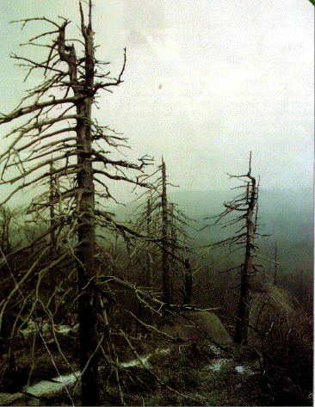

Slide 8
Pollution – Great Lakes
In the 1970s, the Great Lakes had high levels of water pollution.
  Fishing was unsafe; tons of animals and plants were harmed or killed.
Factories around the region used the lakes as a place to dump wastes.
Factories also used the chemical phosphorus when producing things like toothpaste, fertilizer, pesticides, detergents, etc.
  This was really bad for lakes because it caused a rapid increase in algae.

Slide 9
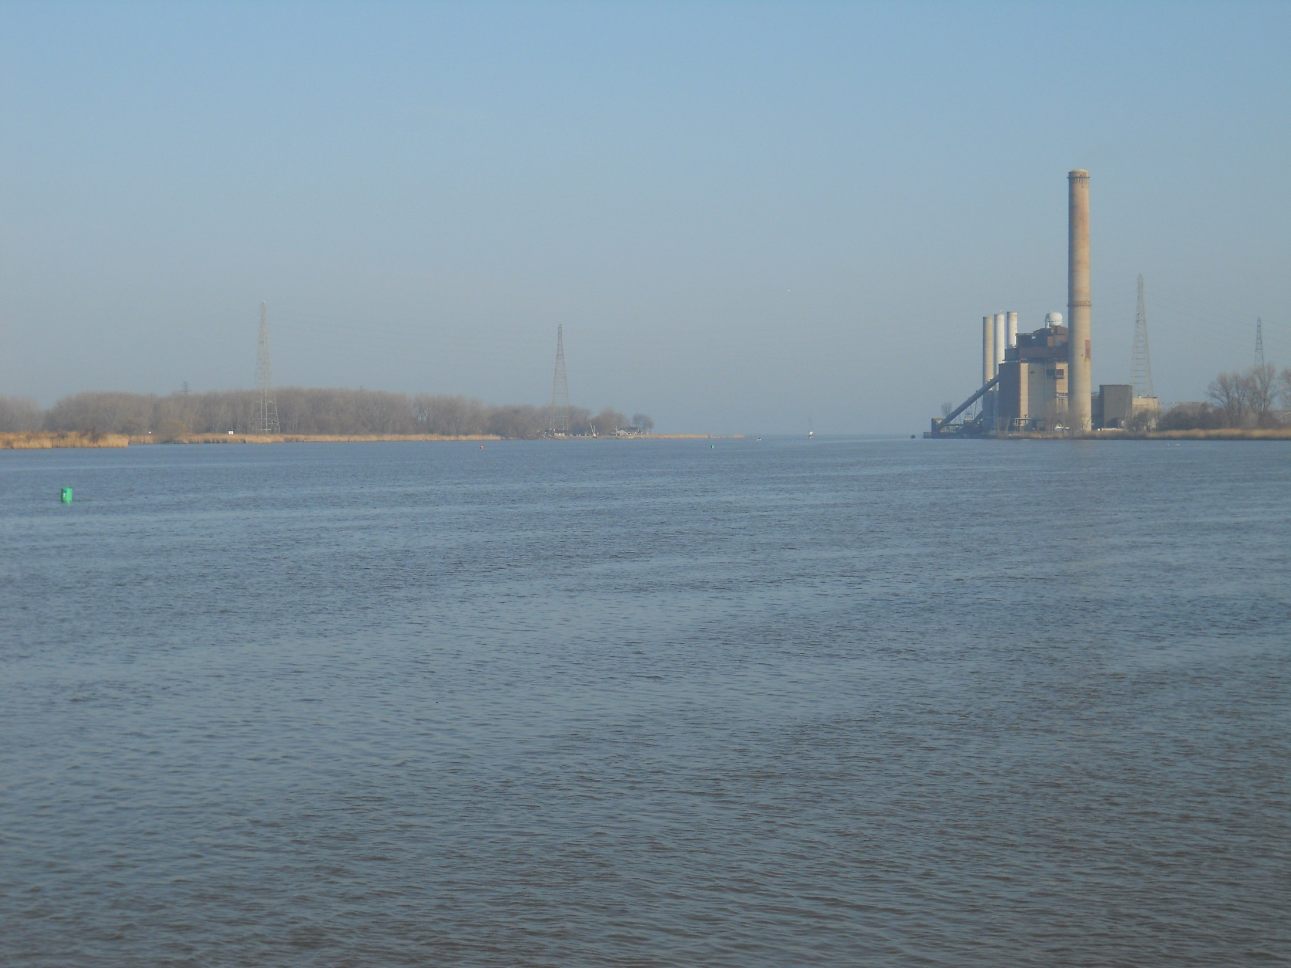

Slide 10
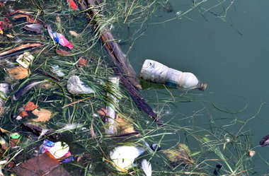

Slide 11
Pollution – Solution
In 1971, the Great Lakes Water Quality Agreement was signed by US and Canada (renewed in 2002).
The goal was to restore the lakes’ environment and to prevent further damage.
  The countries are working together to reduce the amount of human wastes dumped in lakes.
  They’re working to make sure that chemicals (like phosphorus) are not put into lakes.

Slide 12
Extraction of Resources
The Canadian Shield is a large area of thin, rocky soil that surrounds the Hudson Bay.
  Beneath the soil is one of Canada’s most valuable resources: minerals (gold, silver, copper, zinc, lead, iron ore, uranium, & nickel).
Mineral deposits are very important to Canada’s economy because they provide jobs.
  1.5 million people make their living in the mining industry in this area.

Slide 13
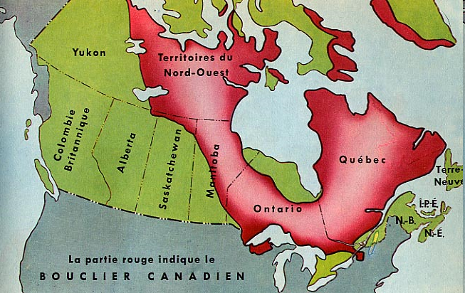

Slide 14
Extraction of Resources
Blasting & digging with heavy machinery causes the land around mines to be damaged and the environment is often ruined.
Slag, or leftover rock from the smelting process, is often dumped in any convenient place.
Mining processes release harmful chemicals into the air, which causes acid rain.

Slide 15
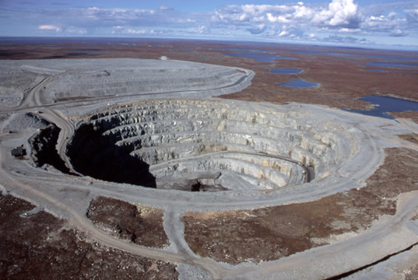
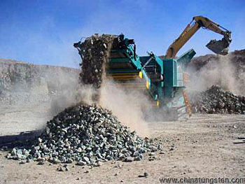

Slide 16
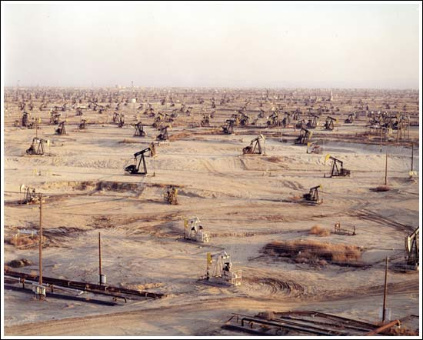
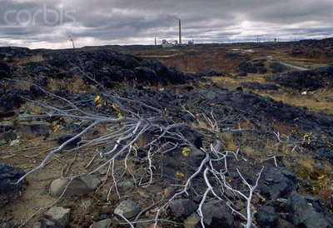

Slide 17
Extraction - Solution
Canada’s government has made new rules about mining.
Some rules reduce the amount of pollution allowed in waterways.
    The government hopes to keep its fish alive and safe to eat.

Slide 18
Timber Industry
With almost half its land covered in forests, Canada is a leading producer of timber products.
  These products include lumber, paper, plywood, and wood pulp.
The major timber-producing provinces include British Columbia, Quebec, and Ontario.

Slide 19
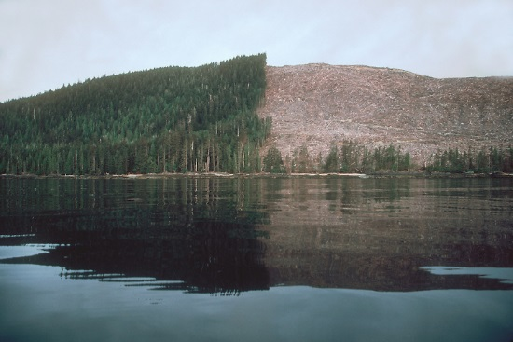
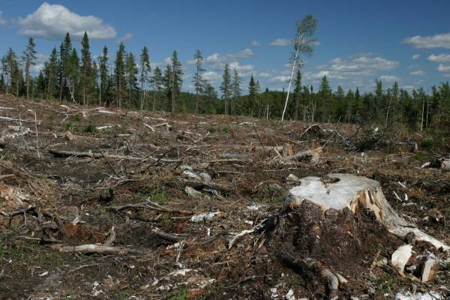

Slide 20
Timber Industry
Citizens are concerned that logging is destroying the forests.
Most timber companies cut all the trees in a given area, leaving large treeless gaps in the forest (called “clear-cutting”).
  This reduces water quality, causes erosion, & kills animals’ habitats.
  Heavy machinery leaves the forest floor compacted and makes it hard for new growth to start.
  Cutting trees down quicker than they can be re-grown is called “deforestation”.
  Trees are a limited resource.
    If they continue to be overused, they will not be renewed.

Slide 21
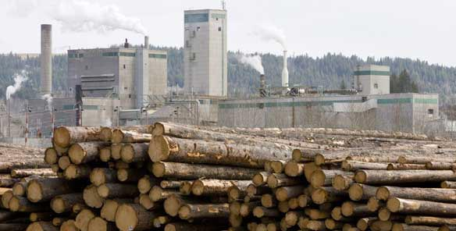
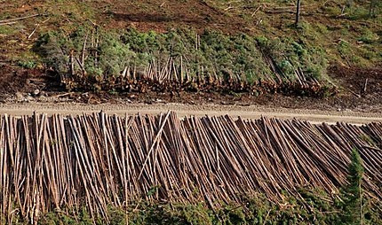

Slide 22
Timber - Solution
Government and industries are working together to manage use of the forests.
Hundreds of millions of seedlings are planted each year.
Billions of dollars are spent on managing and protecting the forests.
  Over $100 million is spent each year by the logging industry to protect wildlife & their habitats.

Slide 23
Canada’s Environmental Concerns Billboard
Choose one of the following environmental concerns to show in your billboard:
  air pollution around Great Lakes
  acid rain around Great Lakes
  over-extraction of minerals in the Canadian Shield
  deforestation
  overfishing
Think of one thing that people might do to help reduce or solve the environmental concern.
Create a billboard that includes images & words that communicate your idea for reducing or solving the problem.
*DESIGN TIPS: A billboard should be so simple that people can get the message as they drive by at high speeds. Get your ideas across quickly using large images and as few words as possible.

Slide 24
