Slide 1






Geography of Europe

Slide 2
Essential Questions:
Where are the major features of Europe located?
Why does location matter?
How does located affect where people live?
How does location affect trade?
How does location help or hinder a country’s development?
Standards:
SS6G7 Locate selected features of Europe. a. Locate on a world and regional political-physical map: the Danube River, Rhine River, English Channel, Mediterranean Sea, European Plain, the Alps, Pyrenees, Ural Mountains, and Iberian Peninsula.
b. Locate on a world and regional political-physical map the countries of France, Germany, Italy, Russia, Spain, Ukraine, and United Kingdom.
Notes:
Instructional Approach(s): The teacher should introduce the essential question and the standards that align to the essential question.

Slide 3
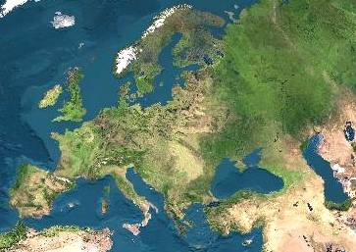
Satellite View of Europe
Notes:
Instructional Approach(s): The teacher should use the image to illustrate the continent of Europe. The teacher may want to ask the class or have students discuss together characteristics of Europe based on the map.

Slide 4
Size Comparison of Europe to the United States
Notes:
Instructional Approach(s): The teacher should use the image to illustrate the size of Europe in comparison to the United States.

Slide 5
Activating Strategy
Use the Europe Physical Features and Nations summarizer to activate student’s prior knowledge of the physical features and nations located in Europe.
Notes:
Instructional Approach(s): Each student should receive a copy of the Europe Physical Features and Nations Summarizer [linked on the curriculum map] to activate student’s prior knowledge of the physical features and nations in Europe. Remind students that they are not supposed to already know this information, but they may have some ideas based on prior learning. Students may do this individually or with a partner. Partners can be determined by the students or the teacher can provide more specific directions such as turn to the person directly in front/behind you or to the right/left of you, etc. It may be necessary to have a group of three if you have an uneven number of students. Do not allow more than 30 seconds to 1 minute of discussion time. The teacher should be walking around listening and redirecting discussions as needed.

Slide 6
Use the European Physical Features Map
Notes:
Instructional Approach(s): Each student should receive a copy of the European Physical Features Map [linked on the curriculum map] to identify the required physical features of Europe during the lesson.

Slide 7
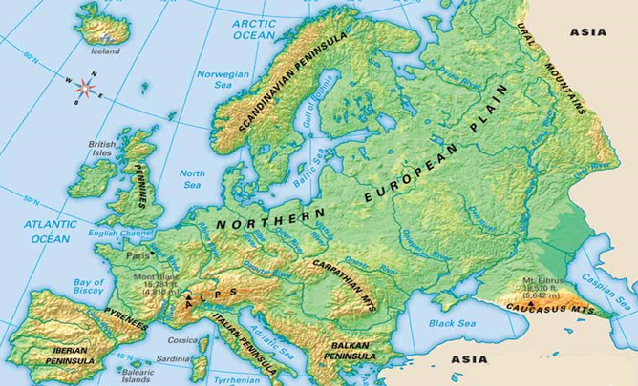
What do you notice is different about the
physical features of Europe on your map?
Notes:
Instructional Approach(s): The teacher should pose the question on the slide to the class. In general, you want students to notice that there are some differences in the features on this map and the one they are using. Point out to students that we are only going to learn the specific physical features identified in the state standards; however, Europe has many more features than those identified in the standard.

Slide 8
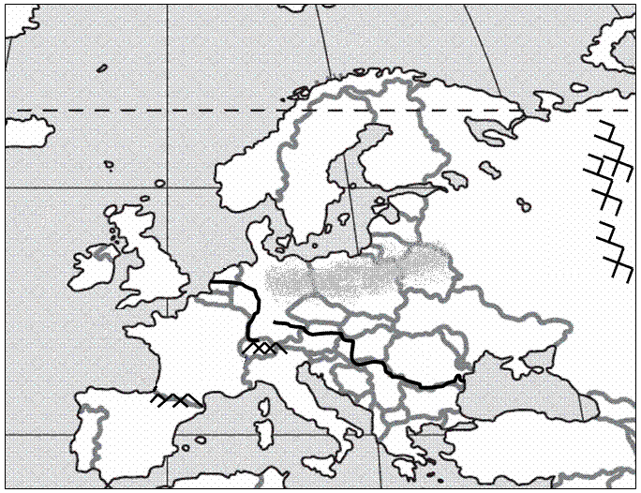
Mediterranean Sea
1
Notes:
Instructional Approach(s): The teacher should use the animated slide to identify the European physical feature on their map. The teacher may want to ask the class if anyone can identify the physical feature before clicking to show the answer.

Slide 9
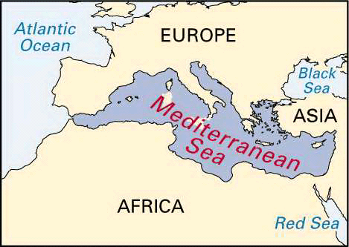
Notes:
Instructional Approach(s): The teacher should use the picture to illustrate the European physical feature.

Slide 10
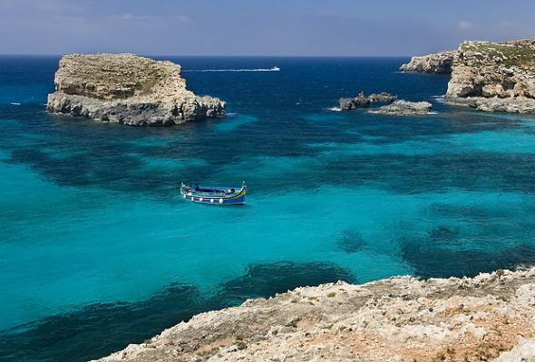
Notes:
Instructional Approach(s): The teacher should use the picture to illustrate the European physical feature.

Slide 11
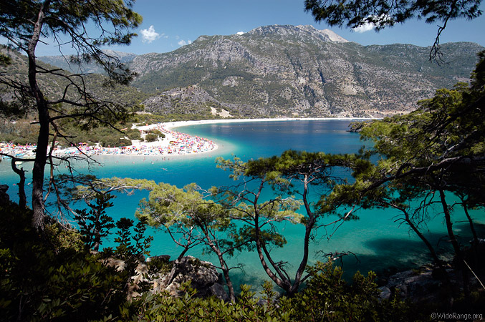
Notes:
Instructional Approach(s): The teacher should use the picture to illustrate the European physical feature.

Slide 12
Iberian Peninsula
2
Notes:
Instructional Approach(s): The teacher should use the animated slide to identify the European physical feature on their map. The teacher may want to ask the class if anyone can identify the physical feature before clicking to show the answer.

Slide 13
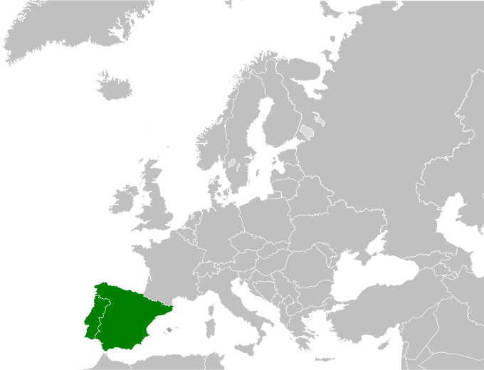
Notes:
Instructional Approach(s): The teacher should use the picture to illustrate the European physical feature.

Slide 14
Pyrenees [Mountains]
3
Notes:
Instructional Approach(s): The teacher should use the animated slide to identify the European physical feature on their map. The teacher may want to ask the class if anyone can identify the physical feature before clicking to show the answer.

Slide 15
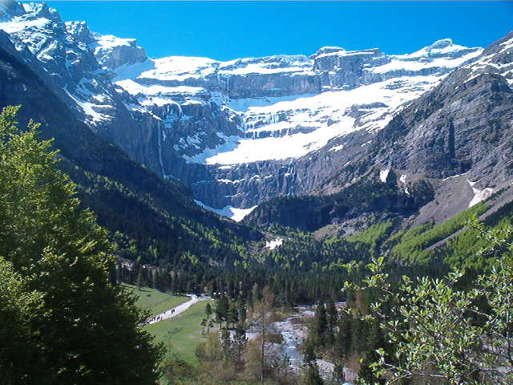
Notes:
Instructional Approach(s): The teacher should use the picture to illustrate the European physical feature.

Slide 16
Alps [Mountains]
4
Notes:
Instructional Approach(s): The teacher should use the animated slide to identify the European physical feature on their map. The teacher may want to ask the class if anyone can identify the physical feature before clicking to show the answer.

Slide 17
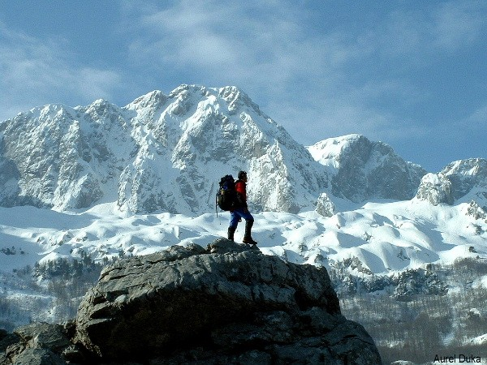
Notes:
Instructional Approach(s): The teacher should use the picture to illustrate the European physical feature.

Slide 18
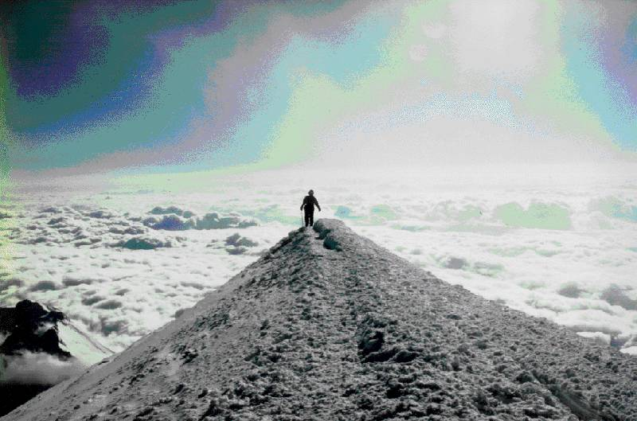
Mt. Blanc in the Alps
It’s the highest mountain in the Alps: 15,771 feet

Slide 19
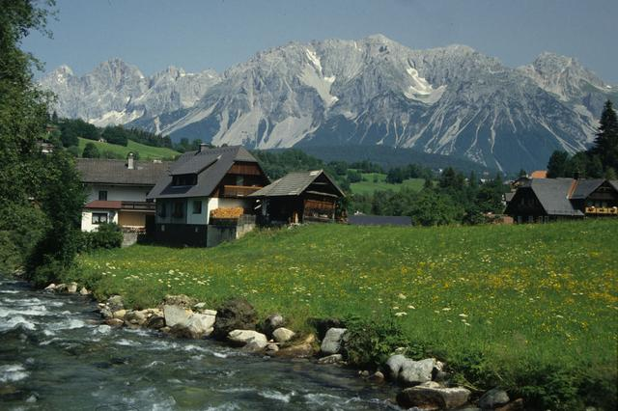
Notes:
Instructional Approach(s): The teacher should use the picture to illustrate the European physical feature.

Slide 20
English Channel
5
Notes:
Instructional Approach(s): The teacher should use the animated slide to identify the European physical feature on their map. The teacher may want to ask the class if anyone can identify the physical feature before clicking to show the answer.

Slide 21
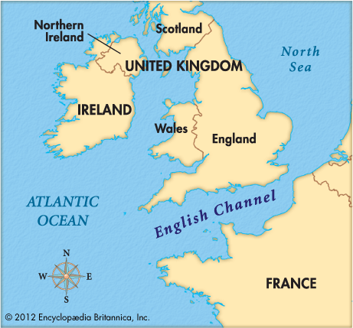
Notes:
Instructional Approach(s): The teacher should use the picture to illustrate the European physical feature.

Slide 22
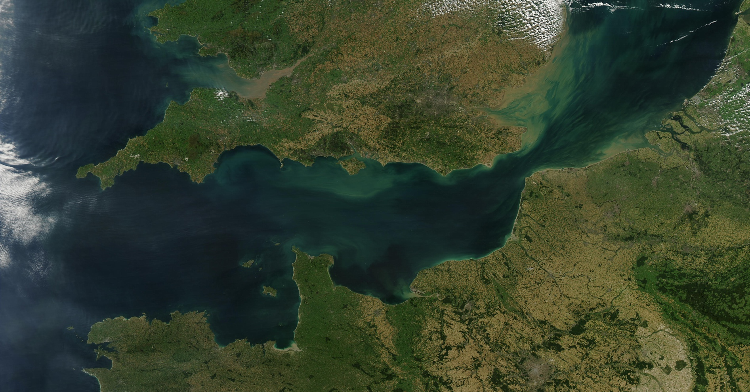
Notes:
Instructional Approach(s): The teacher should use the picture to illustrate the European physical feature.

Slide 23
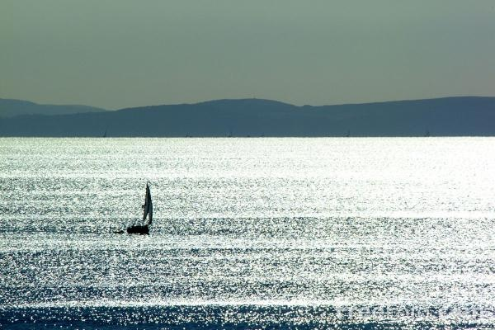
Notes:
Instructional Approach(s): The teacher should use the picture to illustrate the European physical feature.

Slide 24
Rhine River
6
Notes:
Instructional Approach(s): The teacher should use the animated slide to identify the European physical feature on their map. The teacher may want to ask the class if anyone can identify the physical feature before clicking to show the answer.

Slide 25
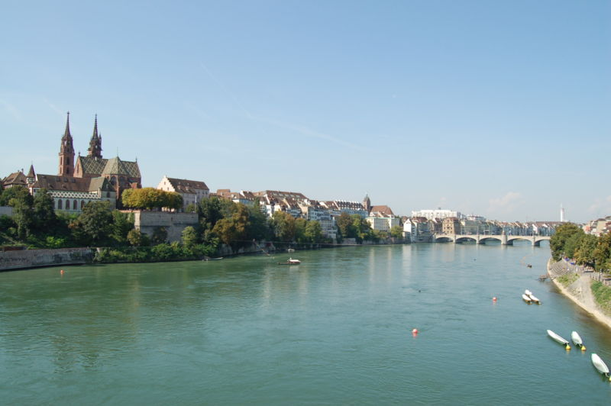
Notes:
Instructional Approach(s): The teacher should use the picture to illustrate the European physical feature.

Slide 26
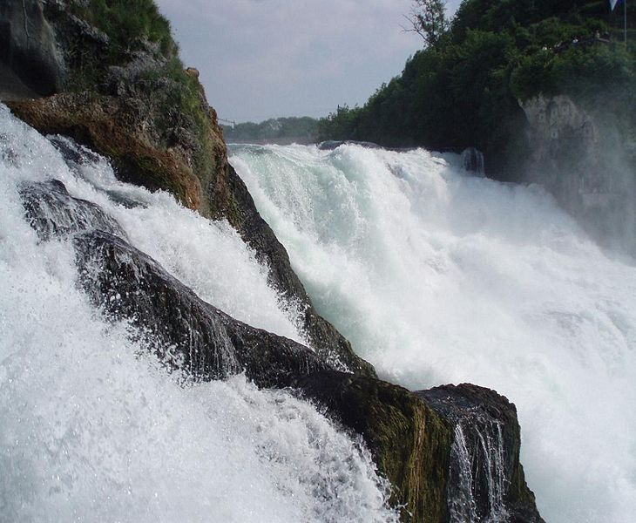
Notes:
Instructional Approach(s): The teacher should use the picture to illustrate the European physical feature.

Slide 27
European Plain
7
Notes:
Instructional Approach(s): The teacher should use the animated slide to identify the European physical feature on their map. The teacher may want to ask the class if anyone can identify the physical feature before clicking to show the answer.

Slide 28
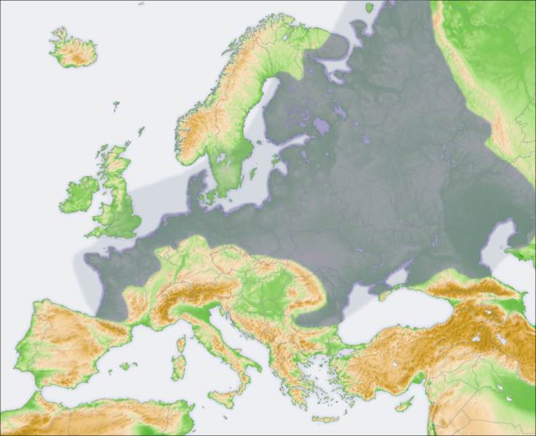
European Plain
Notes:
Instructional Approach(s): The teacher should use the picture to illustrate the European physical feature.

Slide 29
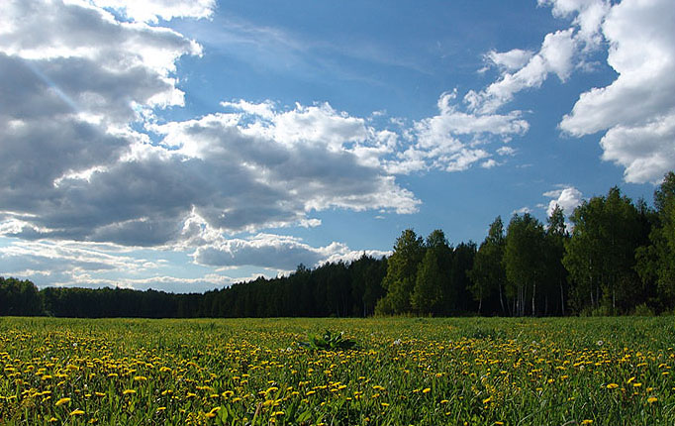
Notes:
Instructional Approach(s): The teacher should use the picture to illustrate the European physical feature.

Slide 30
Danube River
8
Notes:
Instructional Approach(s): The teacher should use the animated slide to identify the European physical feature on their map. The teacher may want to ask the class if anyone can identify the physical feature before clicking to show the answer.

Slide 31
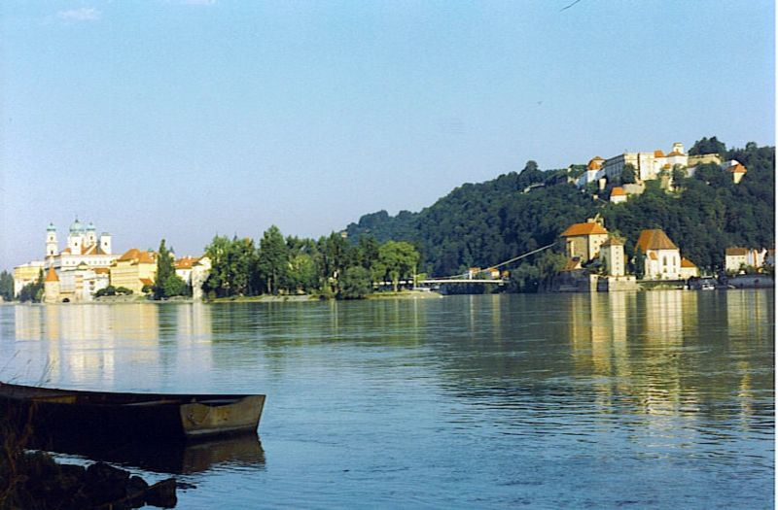
Notes:
Instructional Approach(s): The teacher should use the picture to illustrate the European physical feature.

Slide 32
Ural Mountains
9
Notes:
Instructional Approach(s): The teacher should use the animated slide to identify the European physical feature on their map. The teacher may want to ask the class if anyone can identify the physical feature before clicking to show the answer.

Slide 33
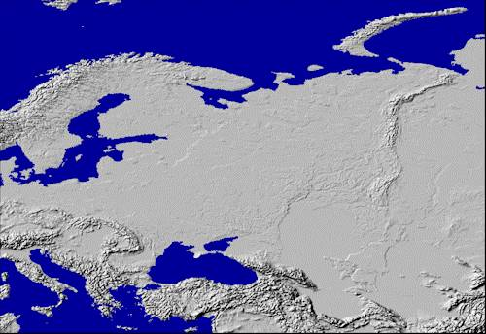
Ural Mountains: “The Great Divide”
1500 miles
It divides the European and Asian sections of Russia.

Slide 34
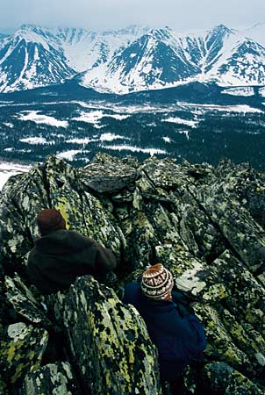
Notes:
Instructional Approach(s): The teacher should use the picture to illustrate the European physical feature.

Slide 35
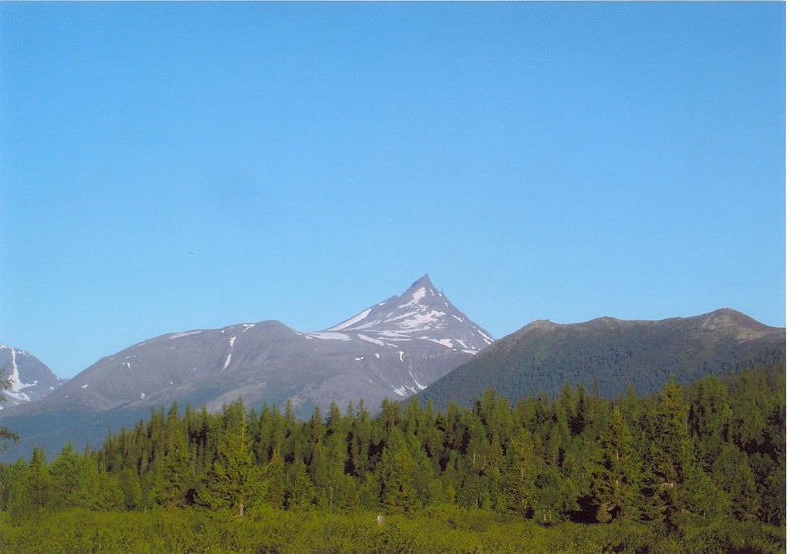
Notes:
Instructional Approach(s): The teacher should use the picture to illustrate the European physical feature.

Slide 36
Scandinavian Peninsula
10
Notes:
Instructional Approach(s): The teacher should use the animated slide to identify the European physical feature on their map. The teacher may want to ask the class if anyone can identify the physical feature before clicking to show the answer.

Slide 37
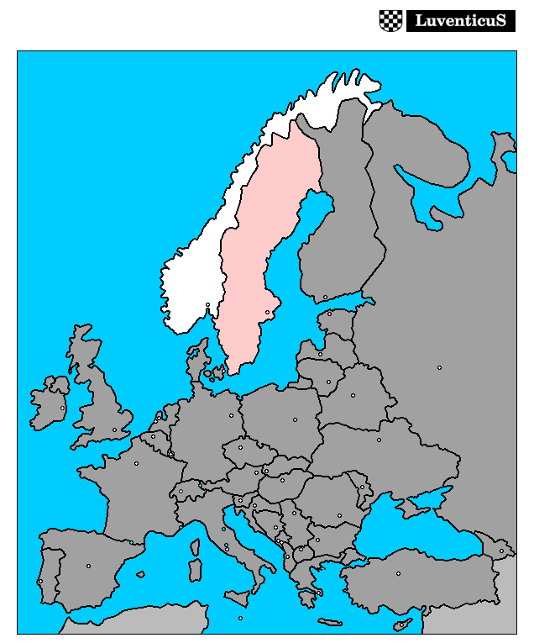
Notes:
Instructional Approach(s): The teacher should use the picture to illustrate the European physical feature.

Slide 38
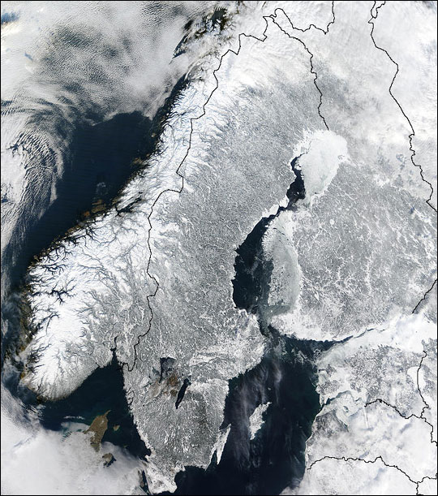
Notes:
Instructional Approach(s): The teacher should use the picture to illustrate the European physical feature.

Slide 39
There are two important oceans surrounding Europe that are not listed in the standards.
However, knowing the location of these oceans is beneficial when describing the location of other physical features in Europe.

Slide 40
Arctic Ocean
11
Notes:
Instructional Approach(s): The teacher should use the animated slide to identify the European physical feature on their map. The teacher may want to ask the class if anyone can identify the physical feature before clicking to show the answer.

Slide 41
Atlantic Ocean
12
Notes:
Instructional Approach(s): The teacher should use the animated slide to identify the European physical feature on their map. The teacher may want to ask the class if anyone can identify the physical feature before clicking to show the answer.

Slide 42
Use your labeled physical features map to:
*Mark each feature on a small map
*Write a description of where the feature is located in Europe
*Write a method for remembering the location of the physical feature
Europe Physical Features Foldable
Notes:
Instructional Approach(s): The teacher should use the Europe Physical Features Foldable [linked on the curriculum map] to reinforce the physical features of Europe.

Slide 43

Distributed Summarizing:
Imagine that you took a European vacation and followed the path shown on the map below. Write a letter to a friend describing the physical features that you visited or crossed during your trip.
Starting
Point
Ending Point
Notes:
Instructional Approach(s): Each student should complete the distributed summarizer [linked on the curriculum map]. The teacher should use the summarizer to determine the level of student mastery and if differentiation is needed.

Slide 44
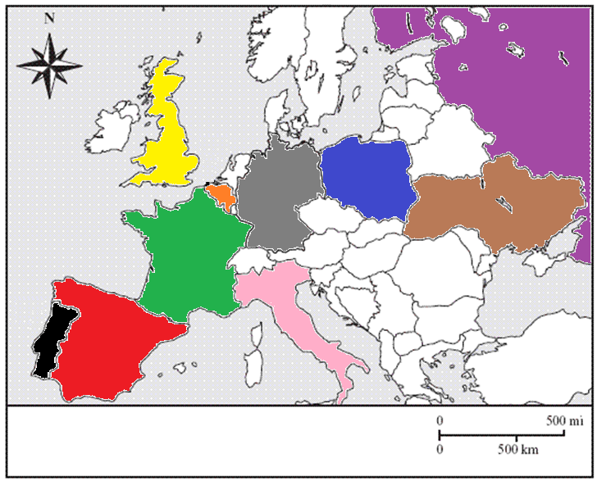
Political Map of Europe
We will identify the nations in color.
Notes:
Instructional Approach(s): The teacher should present the information on the slide.

Slide 45
Use the European Political Identification Map
Notes:
Instructional Approach(s): Each student should receive a copy of the European Political Identification Map [linked on the curriculum map] to identify the required nations of Europe during the lesson.

Slide 46
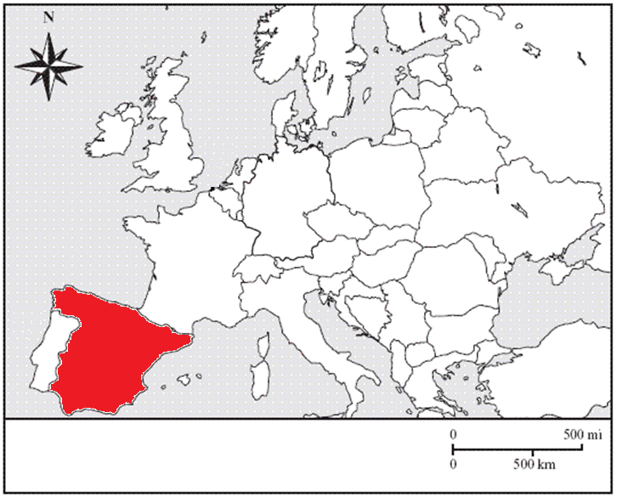
Spain
1
Notes:
Instructional Approach(s): The teacher should use the animated slide to identify the European country on their map. The teacher may want to ask the class if anyone can identify the country before clicking to show the answer.

Slide 47
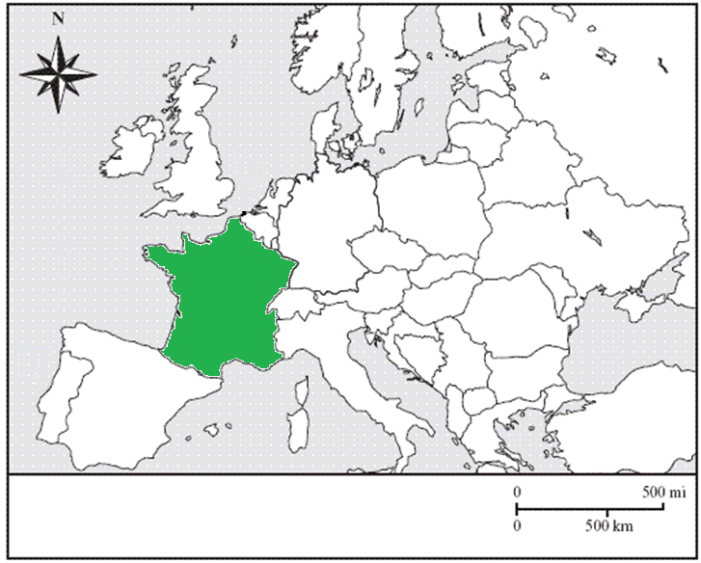
France
2
Notes:
Instructional Approach(s): The teacher should use the animated slide to identify the European country on their map. The teacher may want to ask the class if anyone can identify the country before clicking to show the answer.

Slide 48
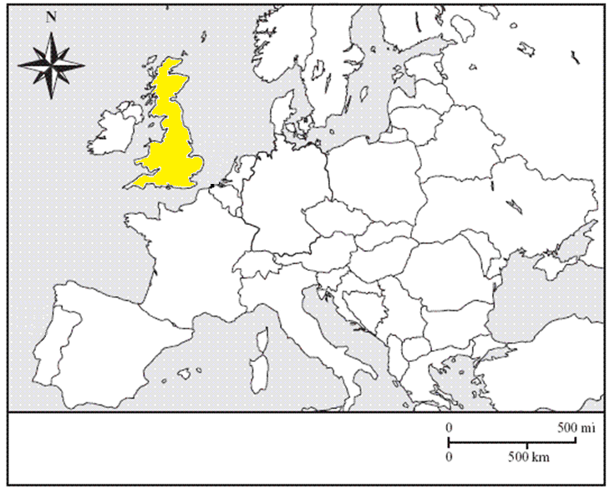
United Kingdom
3
Notes:
Instructional Approach(s): The teacher should use the animated slide to identify the European country on their map. The teacher may want to ask the class if anyone can identify the country before clicking to show the answer.

Slide 49
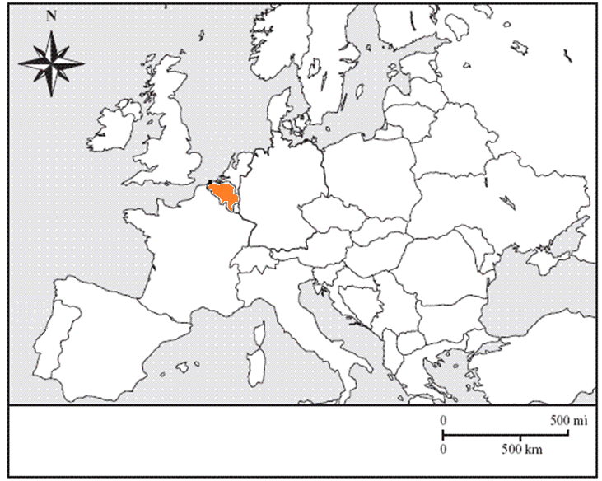
Belgium
4
Notes:
Instructional Approach(s): The teacher should use the animated slide to identify the European country on their map. The teacher may want to ask the class if anyone can identify the country before clicking to show the answer.

Slide 50
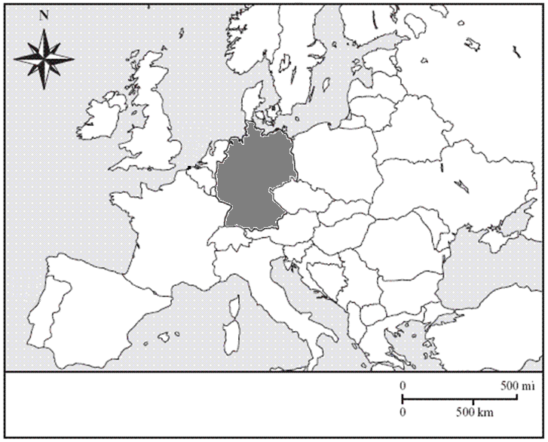
Germany
5
Notes:
Instructional Approach(s): The teacher should use the animated slide to identify the European country on their map. The teacher may want to ask the class if anyone can identify the country before clicking to show the answer.

Slide 51
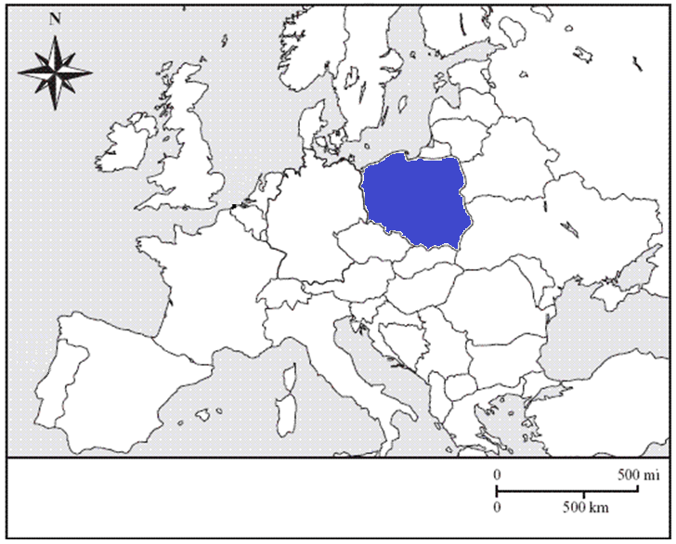
Poland
6
Notes:
Instructional Approach(s): The teacher should use the animated slide to identify the European country on their map. The teacher may want to ask the class if anyone can identify the country before clicking to show the answer.

Slide 52
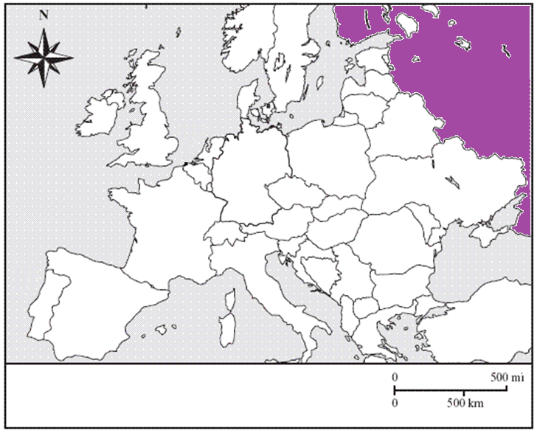
Russia
7
Notes:
Instructional Approach(s): The teacher should use the animated slide to identify the European country on their map. The teacher may want to ask the class if anyone can identify the country before clicking to show the answer.

Slide 53
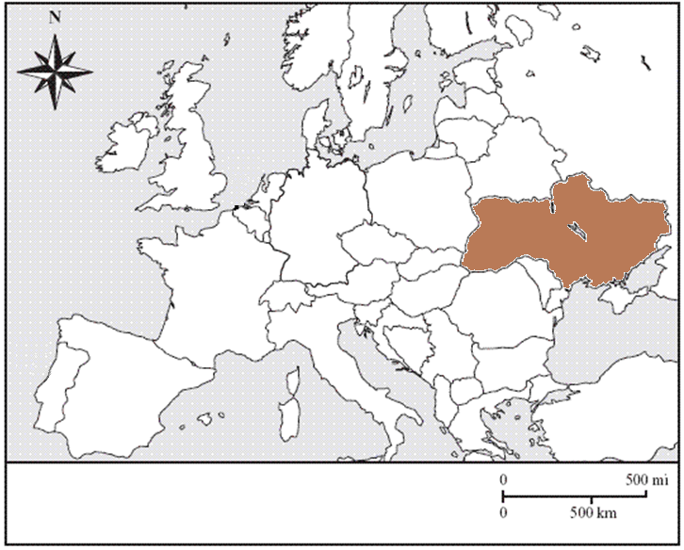
Ukraine
8
Notes:
Instructional Approach(s): The teacher should use the animated slide to identify the European country on their map. The teacher may want to ask the class if anyone can identify the country before clicking to show the answer.

Slide 54
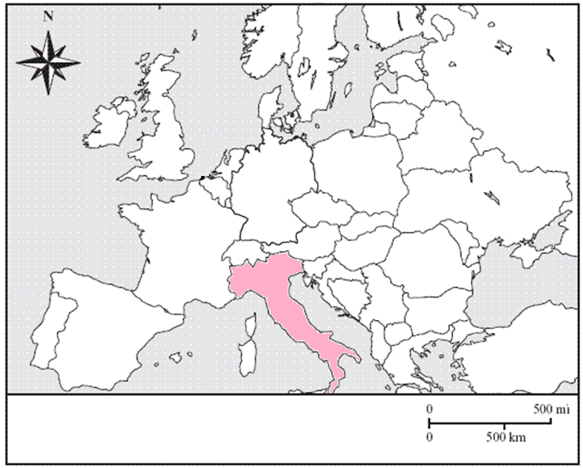
Italy
9
Notes:
Instructional Approach(s): The teacher should use the animated slide to identify the European country on their map. The teacher may want to ask the class if anyone can identify the country before clicking to show the answer.

Slide 55
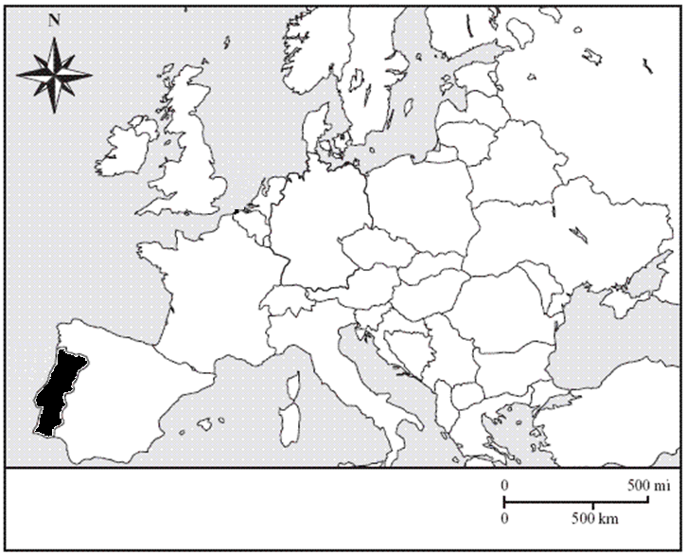
Portugal
10
Notes:
Instructional Approach(s): The teacher should use the animated slide to identify the European country on their map. The teacher may want to ask the class if anyone can identify the country before clicking to show the answer.

Slide 56
Distributed Summarizing: Use your Distributed Summarizing European vacation handout. Identify the European nations that you would have traveled through on your vacation. Write or draw arrows to identify the countries. Which countries did you not visit?
Starting
Point
Ending Point
Notes:
Instructional Approach(s): Each student should complete the distributed summarizer [linked on the curriculum map]. The teacher should use the summarizer to determine the level of student mastery and if differentiation is needed.

Slide 57
Use the Europe Physical Features and Nations PPT Review to quiz students on the location of Europe’s Physical Features and Nations.
Notes:
Instructional Approach(s): The teacher can use the Europe Physical Features and Nations PPT Review [linked on the curriculum map] to review the physical features and countries of Europe.

Slide 58
Summarizing Strategy
Notes:
Instructional Approach(s): Each student should complete the summarizer. The teacher should use the summarizer to determine the level of student mastery and if differentiation is needed.

